Slide 1
Controlling the Page Navigation
(Section 10)

Slide 2
Introduction
Most web applications display some form of visual navigations and provide navigation models to help users move around the pages. ADF Controller is also responsible for transaction management, authorization, and managed bean lifecycle management
ADF Faces leveraged the extensibility options offered by JSF to add more features, keeping the basic architecture in aligned with that of the JSF framework.

Slide 3

The navigation model in the JSF framework
The JSF framework has a very flexible navigation model which decouples navigation rules from the JSF page as well as from underlying business logic.
The JSF 2.0 navigation model supports two types of navigations:
Rule based navigation
Implicit navigation

Slide 4
The navigation model in ADF
Though the control flow features offered by JSF meet the basic requirements of most of the business applications, developers may need to put extra effort in when it comes to really complex use cases. For example:
Implementing page hierarchies, only for top level pages, of an application should be directly accessible through a URL link
Enforcing sequential processing for certain sets of pages to complete the transaction in a predefined order
Reusing control flow cases and associated pages in an application

Slide 5
The navigation model in ADF
There are two types of task flows in ADF:
Unbounded Task Flow: Unbounded task flows are designed to handle navigation between pages which do not necessarily follow any specific entry point or exit point.
Bounded Task Flow: The bounded task flow is primarily designed to implement reusable navigation cases with definite entry and exit points. A bounded task flow contains its own set of control flow rules, activities, and managed beans:
They can have only one entry point for entering into the task flow. However, multiple exit points are supported.
They can take parameters from the caller before starting the execution as well as the return value to the caller after execution.
They can be built either using page fragments or complete JSF pages. iv.

Slide 6
The navigation model in ADF
There are two types of task flows in ADF:
Unbounded Task Flow: Unbounded task flows are designed to handle navigation between pages which do not necessarily follow any specific entry point or exit point.
Bounded Task Flow: The bounded task flow is primarily designed to implement reusable navigation cases with definite entry and exit points. A bounded task flow contains its own set of control flow rules, activities, and managed beans:
They can have only one entry point for entering into the task flow. However, multiple exit points are supported.
They can take parameters from the caller before starting the execution as well as the return value to the caller after execution.
They can be built either using page fragments or complete JSF pages. iv.

Slide 7
The ingredients of an ADF task flow
Task flow configuration files
ADF managed beans
Task flow activities

Slide 8
Task flow configuration files
adfc-config.xml: This file stores the metadata definition for the default unbounded task flow in a Fusion web application. The IDE will generate a brand new adfc-configN.xml file for new unbounded task flows created in the view controller project.
Bounded task flow definition XML: This file stores the metadata definition for a bounded task flow.

Slide 9
ADF managed beans
Managed beans are Java classes used for implementing business logic or data model for your JSF page.
The managed bean can be referred from a JSF page using EL expression.
JSF 2.0 introduced annotations for registering a POJO class as a managed bean and also enabled Contexts and Dependency Injection (CDI) for managing runtime dependencies in a managed bean.

Slide 10
ADF managed bean scopes
Scope | Description
backingBean | The backingBean scope exists for the duration of a request. The backingBean scope is limited to the containing task flow or UI component.
request | The request scope exists for the duration of a request. Unlike the backingBean scope, the request scope is shared across task flows and components in a page.
view | View-scoped memory variables or managed beans exist until the user finishes interaction with the current view.
pageFlow | The pageFlow scope exists across activities for the duration of a task flow. Each task flow has its own pageFlow scoped memory area.
session | The session scope exists for the duration of a user session (HttpSession). It starts when the user starts accessing the application and ends when the session times out, or when the application invalidates the session object.
application | The application scope exists till the application ends. Application scoped memory area is shared across user session and requests.

Slide 11
What you need to know while using managed beans in JSF code?
ADF inherits the request, flash, session, and application scopes from the underlying JSF stack.
If a view activity defined in the task flow uses ADF specific scoped beans, then the corresponding task flow should hold the bean definitions
Prefix all ADF scoped beans with respective scope names while using them in EL expressions. pageFlow : pageFlowScope , backingBean : backingBeanScope , view : viewScope
Note that a managed bean with request, session or application scopes do not require any prefixing.

Slide 12
Task flow activities
An activity represents a unit of the task performed when the task flow runs. The task flow activity list includes view, method call, control flow router, task flow call, parent action, and task flow return. Note that the task flow return and parent action activities are specific to bounded task flows alone, and are not applicable for unbounded task flows.

Slide 13
View activity
The view activity represents a complete JSF page or page fragment that forms a unit of the task in the task flow. Page fragments are useful when you build a bounded task flow which requires to be embedded in a parent JSF page as a region.

Slide 14
Facelet or JSP XML
ADF Faces allows you to build a view activity using either Facelet or JSP XML as a document type. You may find the same set of design time features for both these types of pages. However, they differ considerably when it comes to the rendering of views at runtime. If you are building new Fusion web applications, it is strongly recommended you choose Facelet as a document type.

Slide 15
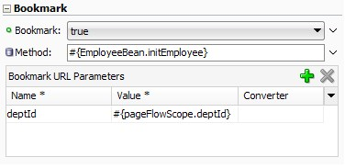
Bookmarking view activity
When a user navigates between views in a Fusion web application, by default, the browser URL may not reflect the actual view you are currently watching. Though this has certain performance benefits, the user may not be able to bookmark these views as the browser URL does not reflect the actual resource.

Slide 16
Redirect URL
However, you can make the ADF Controller issue a redirect request for a view activity by setting the Redirect property to true for the desired view activity. In this case, the ADF Controller issues a redirect dispatching request for the resource and the URL displayed in the browser will reflect the actual page that the user is working on.

Slide 17
URL view activity
The URL view activity represents URL locatable resources such as bounded task flows as a whole, view activities in an unbounded task flow and external website addresses.
< url-view id="google" >
<url>http://www.google.com</url>
< /url-view >

Slide 18
Building an unbounded task flow
If your application grows and you have to deal with more number of pages and navigation rules? A quite obvious solution for such cases is to split the view controller project into multiple projects and use multiple task flow configuration files to hold the controller metadata definitions, and assemble all these pieces while generating the final deployable artefacts for the application. The ADF framework enables modular web development through bounded and unbounded task flows.

Slide 19
Using a managed bean to return a dynamic outcome for a navigation component
The framework also allows you to execute some business logic for deciding the outcome using action methods defined in managed beans. An action method should return either a String or Object with the toString() implementation. To use the outcome returned by a method defined in a bean, you must refer to the method using an EL expression for the action attribute.

Slide 20
Conditionally executing a control flow case
You can specify the EL expression as a guard condition for control flow execution.
Select the control flow case in the task flow diagram, expand the Behavior section in the property inspector and specify the EL expression that evaluates to true or false, as a value for the If field.

Slide 21
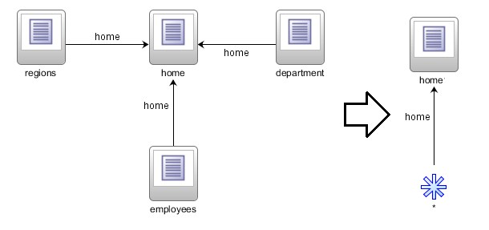
Improving the readability of control flow cases
If you have control flow cases defined from multiple source views to a single destination view, you can make it more readable using the wildcard control flow rule (represented by the * symbol) as shown in the following screenshot:

Slide 22
Adding an exception handler
An exception handler is the central place for handling unexpected exceptions in an application. ADF allows you to handle such erroneous scenarios in a more user friendly way by designating one activity in a bounded or unbounded task flow as an exception handler.

Slide 23
Building a menu model
JDeveloper has design time support for generating an XML menu model from unbounded task flow activities, which can be used as a data model for navigation components

